Slide 1
Data Communication and Networking (DCAN 202)
Week 9

Slide 2
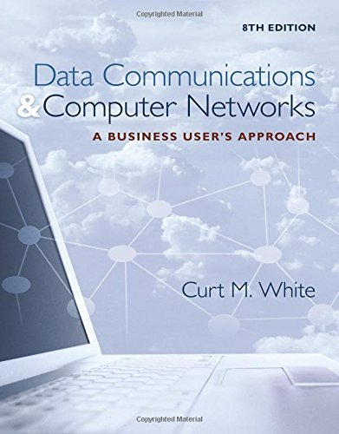
Chapter 12: Network Design, Security and Risks, Networks and Communications Serving Modern Businesses.
Data Communications and Computer Networks: A Business User's Approach, Eighth Edition
© 2016. Cengage Learning. All right reserved.

Slide 3
Todays Lecture
Basic forms of system attacks
Concepts underlying physical protection measures
Techniques used to control access to computers and networks
Discuss the strengths and weaknesses of passwords
Techniques used to make data secure
Difference between a substitution-based cipher and a transposition-based cipher
Basic features of public key cryptography, Advanced Encryption Standard, digital signatures, and the public key infrastructure
Techniques used to secure communications
Differences between the frequency hopping spread spectrum technique and the direct sequence spread spectrum technique
Importance of a firewall, two basic types of firewall protection
Techniques used to secure wireless communications
Advantages to a business of having a security policy

Slide 4
Introduction
While computer systems today have some of the best security systems ever, they are more vulnerable than ever before
This vulnerability stems from the world-wide access to computer systems via the Internet
Computer and network security comes in many forms, including encryption algorithms, access to facilities, digital signatures, and using fingerprints and face scans as passwords

Slide 5
Standard System Attacks
Viruses
Computer virus – small program that alters the way a computer operates and often does various types of damage by deleting and corrupting data and program files, or by altering operating system components, so that computer operation is impaired or even halted
Many different types of viruses, such as parasitic, boot sector, stealth, polymorphic, and macro
Worms
Computer worm – program that copies itself from one system to another over a network, without the assistance of a human being
Worms usually propagate themselves by transferring from computer to computer via e-mail
Typically, a virus or a worm is transported as a Trojan horse
In other words, hiding inside a harmless-looking piece of code such as an e-mail or an application macro

Slide 6
Standard System Attacks
Two popular forms of attacks:
Socially engineered attack – a bogus link in a web page that leads to no good
Exploiting known vulnerabilities in operating systems and application software
For both of these, software company issues a patch
Patch may fix it, or introduce even more holes
Either way, bad guys find new holes and exploit
Very common way to attack vulnerability is via an e-mail attachment
You open the attachment and you launch the virus
Second common way to attack is to simply scan your computer ports while you are connected to the Internet (either dial-up or non-dial-up)
If you have an open port, hacker will download malicious software to your machine

Slide 7
Standard System Attacks
Other standard attacks
Denial of service attacks, or distributed denial of service attacks
Bombard computer site with so many messages that site is incapable of answering valid request
E-mail bombing
User sends an excessive amount of unwanted e-mail to someone
Botnets
Malicious programs that take over operations on a comprised computer
Smurfing
Nasty technique in which a program attacks a network by exploiting IP broadcast addressing operations
Ping storm
Condition in which the Internet ping program is used to send a flood of packets to a server

Slide 8
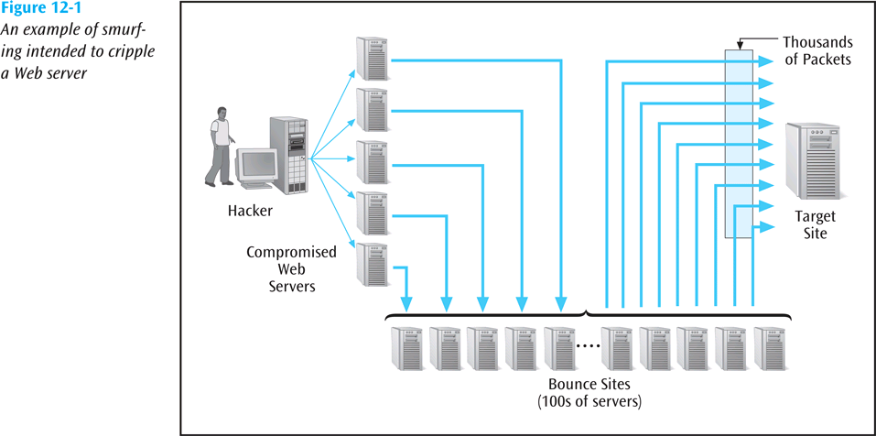
Standard System Attacks
An example of smurfing intended to cripple a web server
Data Communications and Computer Networks: A Business User's Approach, Eighth Edition
© 2016. Cengage Learning. All Rights Reserved.

Slide 9
Standard System Attacks
Other standard attacks (continued)
Spoofing
When a user creates a packet that appears to be something else or from someone else
Trojan Horse
Malicious piece of code hidden inside a seemingly harmless piece of code.
Stealing, guessing, and intercepting passwords is also a tried and true form of attack

Slide 10
Standard System Attacks
Other standard attacks (continued)
Phishing
Hackers create emails which look as if they are coming from a legit source when in reality the hacker is trying to get the user to give up ID and password info
Pharming
Hacker redirects unknowing user to bogus look-alike website
Rootkit
A program that has been installed deep within a user’s operating system; defies detection and takes over the user’s computer
Keylogger
A software system that secretly captures and records keystrokes made at a user’s keyboard

Slide 11
Physical Protection
Protection from environmental damage such as floods, earthquakes, and heat
Physical security such as locking rooms, locking down computers, keyboards, and other devices
Electrical protection from power surges
Noise protection from placing computers away from devices that generate electromagnetic interference

Slide 12
Physical Protection (continued)
Surveillance
Proper placement of security cameras can deter theft and vandalism
Cameras can also provide a record of activities
Intrusion detection is a field of study in which specialists try to prevent intrusion and try to determine if a computer system has been violated
Honeypot is an indirect form of surveillance
Network personnel create a trap, watching for unscrupulous activity

Slide 13
Controlling Access
Deciding who has access to what
Limiting time of day access
Limiting day of week access
Limiting access from a location, such as not allowing a user to use a remote login during certain periods of time

Slide 14
Passwords and ID Systems
Passwords are the most common form of security and the most abused
Simple rules help support safe passwords, including:
Change your password often
Pick a good, random password (minimum 8 characters, mixed symbols)
Don’t share passwords or write them down
Don’t select names and familiar objects as passwords

Slide 15
Passwords and ID Systems (continued)
Many new forms of “passwords” are emerging (biometrics):
Fingerprints
Face prints
Retina scans and iris scans
Voice prints
Ear prints (?)

Slide 16
Access Rights
Two basic questions to access rights:
Who and how?
Who do you give access rights to?
No one, group of users, entire set of users?
How does a user or group of users have access?
Read, write, delete, print, copy, execute?
Most network operating systems have a powerful system for assigning access rights

Slide 17
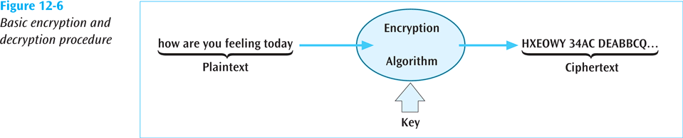
Basic Encryption and Decryption Techniques
Cryptography – study of creating and using encryption and decryption techniques
Plaintext – data before any encryption has been performed
Ciphertext – data after encryption has been performed
The key is the unique piece of information that is used to create ciphertext and decrypt the ciphertext back into plaintext
Basic Encryption and Decryption procedure
Data Communications and Computer Networks: A Business User's Approach, Eighth Edition
© 2016. Cengage Learning. All Rights Reserved.

Slide 18
Monoalphabetic Substitution-Based Ciphers
Monoalphabetic substitution-based ciphers replace a character or characters with a different character or characters, based upon some key
Replacing: abcdefghijklmnopqrstuvwxyz
with: POIUYTREWQLKJHGFDSAMNBVCXZ
The message: how about lunch at noon
encodes into: EGVPO GNMKN HIEPM HGGH

Slide 19
Polyalphabetic Substitution-Based Ciphers
Similar to monoalphabetic ciphers except multiple alphabetic strings are used to encode the plaintext
Example – matrix of strings, 26 rows by 26 characters or columns can be used
A key such as COMPUTERSCIENCE is placed repeatedly over the plaintext
COMPUTERSCIENCECOMPUTERSCIENCECOMPUTER
thisclassondatacommunicationsisthebest

Slide 20
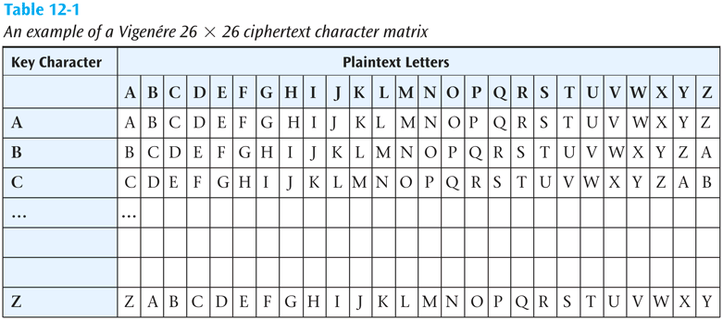
Polyalphabetic Substitution-Based Ciphers (continued)
To encode the message, take the first letter of the plaintext, t, and the corresponding key character immediately above it, C
Go to row C column t in the 26x26 matrix and retrieve the ciphertext character V
Continue with the other characters in plaintext

Slide 21
Transposition-Based Ciphers
In a transposition-based cipher, the order of the plaintext is not preserved
As a simple example, select a key such as COMPUTER
Number the letters of the word COMPUTER in the order they appear in the alphabet
1 4 3 5 8 7 2 6
C O M P U T E R

Slide 22
Transposition-Based Ciphers (continued)
Now take the plaintext message and write it under the key
1 4 3 5 8 7 2 6
C O M P U T E R
t h i s i s t h
e b e s t c l a
s s i h a v e e
v e r t a k e n

Slide 23
Transposition-Based Ciphers (continued)
Then read the ciphertext down the columns, starting with the column numbered 1, followed by column number 2
TESVTLEEIEIRHBSESSHTHAENSCVKITAA

Slide 24
Public Key Cryptography
Very powerful encryption technique in which two keys are used
First key (the public key) encrypts the message
Second key (the private key) decrypts the message
Not possible to deduce one key from the other
Not possible to break code given public key
If you want someone to send you secure data, give them your public key, you keep the private key
Secure Sockets Layer on the Internet is a common example of public key cryptography

Slide 25
Data Encryption Standard and Advanced Encryption Standard
Created in 1977 and in operation into the 1990s, the Data Encryption Standard took a 64-bit block of data and subjected it to 16 levels of encryption
The choice of encryption performed at each of the 16 levels depends on the 56-bit key applied
Even though 56 bits provides over 72 quadrillion combinations, a system using this standard has been cracked (in 1998 by Electronic Frontier Foundation in 3 days)

Slide 26
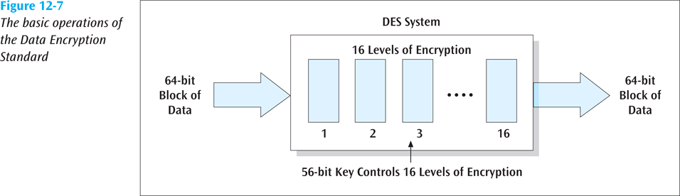
Data Encryption Standard and Advanced Encryption Standard (continued)
Data Communications and Computer Networks: A Business User's Approach, Eighth Edition
© 2016. Cengage Learning. All Rights Reserved.

Slide 27
Data Encryption Standard and Advanced Encryption Standard (continued)
Triple-DES
More powerful data encryption standard
Data is encrypted using DES three times:
First time by the first key
Second time by a second key
Third time by the first key again
Can also have 3 unique keys
While virtually unbreakable, triple-DES is CPU intensive
With more smart cards, cell phones, and PDAs, a faster (and smaller) piece of code is highly desirable

Slide 28
Data Encryption Standard and Advanced Encryption Standard (continued)
Advanced Encryption Standard (AES)
Selected by the U.S. government to replace DES
National Institute of Standards and Technology selected the algorithm Rijndael (pronounced rain-doll) in October 2000 as the basis
Has more elegant mathematical formulas, requires only one pass, and was designed to be fast, unbreakable, and able to support even the smallest computing device

Slide 29
Data Encryption Standard and Advanced Encryption Standard (continued)
Advanced Encryption Standard (AES) (continued)
Key size of AES: 128, 192, or 256 bits
Estimated time to crack (assuming a machine could crack a DES key in 1 second) : 149 trillion years
Very fast execution with very good use of resources

Slide 30
Digital Signatures
Document to be signed is sent through a complex mathematical computation that generates a hash (large prime number).
Hash is encoded with owner’s private key then stored
To prove future ownership, stored hash is decoded using the owner’s public key and that hash is compared with a current hash of the document
If the two hashes agree, document belongs to the owner
U.S. accepts digitally signed documents as legal proof (for some types of documents)

Slide 31
Pretty Good Privacy (PGP)
Encryption software created by Philip Zimmermann
Can be used to secure email and other data files
Employs public key cryptography and digital signatures

Slide 32
Kerberos
An authentication protocol designed to work on client/server networks
Employs both private key cryptography (one key both encrypts and decrypts) and public key cryptography (two separate keys)
Another free software for use in the U.S.
Many operating systems provide Kerberos for authentication of users and services

Slide 33
Public Key Infrastructure
Combination of encryption techniques, software, and services that involves all the necessary pieces to support digital certificates, certificate authorities, and public key generation, storage, and management
A certificate, or digital certificate, is an electronic document, similar to a passport, that establishes your credentials when you are performing transactions
A digital certificate contains your name, serial number, expiration dates, copy of your public key, and digital signature of certificate-issuing authority.
Certificates are usually kept in a registry so other users may check them for authenticity.

Slide 34
Public Key Infrastructure (continued)
Certificates are issued by a certificate authority (CA)
A CA is either specialized software on a company network or a trusted third party
Let’s say you want to order something over the Internet
The Web site wants to make sure you are legit, so the Web server requests your browser to sign the order with your private key (obtained from your certificate)
The Web server then requests your certificate from the third party CA, validates that certificate by verifying third party’s signature, then uses that certificate to validate the signature on your order
The user can do the same procedure to make sure the Web server is not a bogus operation
A certificate revocation list is used to “deactivate” a user’s certificate

Slide 35
Public Key Infrastructure (continued)
Applications that could benefit from PKI:
Web transactions
Virtual private networks
Electronic mail
Client-server applications
Banking transactions

Slide 36
Steganography
The art and science of hiding information inside other, seemingly ordinary messages or documents
Unlike sending an encrypted message, you do not know when steganography is hiding a secret message within a document
Examples include creating a watermark over an image or taking “random” pixels from an image and replacing them with the hidden data

Slide 37
Securing Communications
So far we have examined standard system attacks, physical protection, controlling access, and securing data
Now let’s examine securing communications
One way to secure the transfer of data is to scramble the signal as it is being transmitted
This is called spread spectrum technology

Slide 38
Spread Spectrum Technology
A secure encoding technique that uses multiple frequencies or codes to transmit data.
Two basic spread spectrum technologies:
Frequency hopping spread spectrum
Direct sequence spread spectrum

Slide 39
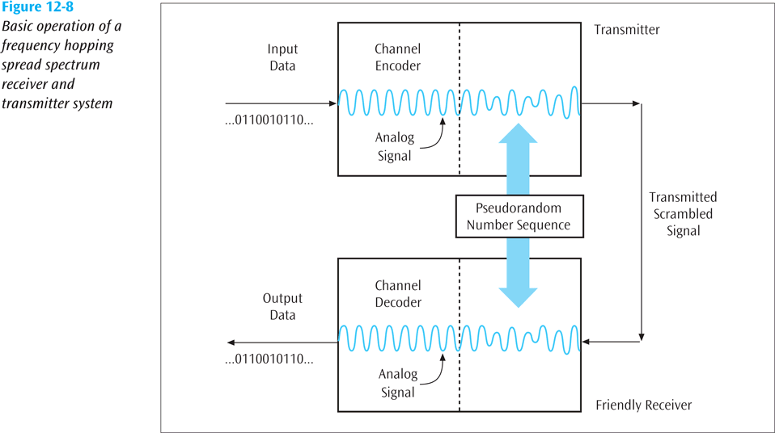
Spread Spectrum Technology (continued)
Data Communications and Computer Networks: A Business User's Approach, Eighth Edition
© 2016. Cengage Learning. All Rights Reserved.

Slide 40
Spread Spectrum Technology (continued)
Direct sequence spread spectrum
This technology replaces each binary 0 and binary 1 with a unique pattern, or sequence, of 1s and 0s
For example, one transmitter may transmit the sequence 10010100 for each binary 1, and 11001010 for each binary 0
Another transmitter may transmit the sequence 11110000 for each binary 1, and 10101010 for each binary 0

Slide 41
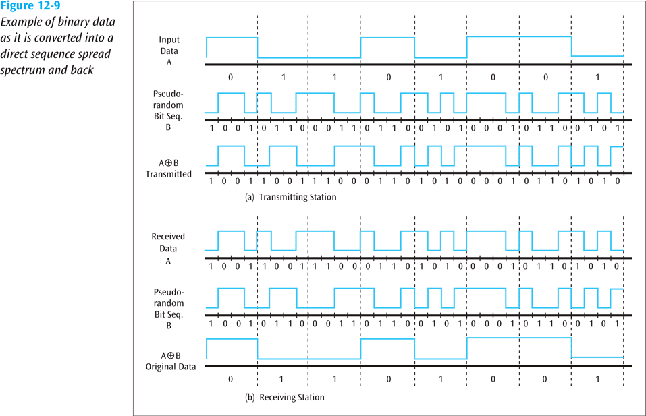
Spread Spectrum Technology (continued)
Data Communications and Computer Networks: A Business User's Approach, Eighth Edition
© 2016. Cengage Learning. All Rights Reserved.

Slide 42
Guarding Against Viruses
Signature-based scanners look for particular virus patterns or signatures and alert the user
Terminate-and-stay-resident programs run in the background constantly watching for viruses and their actions
Multi-level generic scanning is a combination of antivirus techniques including intelligent checksum analysis and expert system analysis

Slide 43
Firewalls
A system or combination of systems that supports an access control policy between two networks
Can limit the types of transactions that enter a system, as well as the types of transactions that leave a system
Can be programmed to stop certain types or ranges of IP addresses, as well as certain types of TCP port numbers (applications)

Slide 44
Three Basic Types of Firewalls
Packet filter firewall – essentially a router that has been programmed to filter out or allow to pass certain IP addresses or TCP port numbers
Proxy server – more advanced firewall that acts as a doorman into a corporate network
Any external transaction that requests something from the corporate network must enter through the proxy server
Proxy servers are more advanced but make external accesses slower
Application layer – inspects all packets coming into or leaving a connection using the application layer of the TCP/IP protocol suite
Goes beyond IP addresses and TCP port numbers and inspects packet to see to which application it belongs

Slide 45
Wireless Security
How do you make a wireless LAN secure?
WEP (Wired Equivalency Protocol) was the first security protocol used with wireless LANs
It had weak 40-bit static keys and was too easy to break
WPA (Wi-Fi Protected Access) replaced WEP
Major improvement including dynamic key encryption and mutual authentication for wireless clients

Slide 46
Wireless Security (continued)
Both of these should eventually give way to a new protocol created by the IEEE
IEEE 802.11i, or WPA2
WPA2 allows keys, encryption algorithms, and negotiation to be dynamically assigned
Also, AES encryption based on the Rijndael algorithm with 128-, 192-, or 256-bit keys is incorporated

Slide 47
Security Policy Design Issues
What is the company’s desired level of security?
How much money is the company willing to invest in security?
If the company is serious about restricting access through an Internet link, what about restricting access through all other entry ways?
The company must have a well-designed security policy

Slide 48
Cybersecurity Tools: Your Digital Defense Arsenal
Wireshark: Network Packet Analyzer
Wireshark is a free and open-source packet analyzer used for network troubleshooting, analysis, and education.
Key Features:
Captures live network traffic for analysis.
Deep inspection of hundreds of protocols.
Filters and highlights specific network packets.
Saves data for offline analysis.
User-friendly interface with extensive protocol support.
Cross-platform compatibility (Windows, macOS, Linux).
Website: www.wireshark.org

Slide 49
Cybersecurity Tools: Your Digital Defense Arsenal (Continued)
Kali Linux: The Penetration Testing OS
Kali Linux is a Debian-based Linux distribution designed for ethical hacking and cybersecurity testing.
Key Features:
Pre-installed with 600+ penetration testing tools.
Supports live boot and installation on multiple platforms.
Includes tools for forensics, password cracking, and network analysis.
Regular updates with new tools and features.
Website: www.kali.org

Slide 50
Cybersecurity Tools: Your Digital Defense Arsenal (Continued)
Nmap: Network Scanning and Vulnerability Assessment
Nmap is a powerful tool for network discovery and security auditing. Highly versatile and widely supported.
Key Features:
Port scanning to identify open ports.
OS detection and service fingerprinting.
Advanced scripting capabilities for automation.
Supports large-scale network scans.
Website: nmap.org

Slide 51
Cybersecurity Tools: Your Digital Defense Arsenal (Continued)
Autopsy: Digital Forensics Platform
Autopsy is a free, open-source tool for analyzing digital evidence.
Key Features:
Investigating cybercrimes and data breaches.
Timeline analysis for tracking user activities.
File recovery, including deleted files.
Email analysis and keyword search capabilities.
Plugin support for extensibility.
Website: www.sleuthkit.org/autopsy

Slide 52
Cybersecurity Tools: Your Digital Defense Arsenal (Continued)
OSINT: Harnessing Public Data for Cybersecurity
OSINT (Open Source Intelligence) refers to the collection and analysis of publicly available information to gain insights for intelligence purposes. OSINT is widely used in fields such as cybersecurity, law enforcement, and corporate security.
Popular OSINT Tools:
OSINT Framework: A web-based framework that organizes OSINT tools and resources by categories. https://osintframework.com/
Maltego: Visual link analysis for relationships and connections.
https://www.maltego.com/
Shodan: Search engine for Internet-connected devices.
https://www.shodan.io/
theHarvester: Collects email addresses, subdomains, and IPs.
https://github.com/laramies/theHarvester

Slide 53
Summary
Network security continues to be an increasingly important topic, particularly with increase in network interconnectivity
Two most common system attacks are:
Socially engineered attacks
Attacking known OS and application software vulnerabilities
Network personnel and users must take physical protection measures
Controlling access to computer system and its network is an essential aspect of network security

Slide 54
Summary (continued)
Passwords and other ID systems are very common access-controlling security techniques
Passwords can be stolen and used by unscrupulous parties
Most computer systems apply access rights to resources of the system and users
Software that conducts continuous audit of network transactions creates electronic trail that companies can use when trying to catch malicious users
Providing security for system data is just as important as securing the system itself

Slide 55
Summary (continued)
Public key cryptography uses two keys
One key to encode messages
Second key to decode messages
Data Encryption Standard was created in 1977 and uses a 56-bit key to encrypt data transmitted between two business locations
Digital signatures use public key cryptography and can be used to verify that a given document belongs to given person
Pretty Good Privacy is free encryption software that allows regular users as well as commercial users to encrypt and decrypt everyday transmissions

Slide 56
Summary (continued)
In order to secure communications, network administrators and users must be aware of standard computer attacks and viruses that can damage computer systems
Another means of securing communications is a firewall, a system or combination of systems that supports an access control policy between two networks
Securing wireless networks is a new and exciting field of study
A proper network security design helps corporate network staff by clearly delineating which network transactions are acceptable

